Slide 1

Predictive Modeling
Sakshi Sahu
Data Science Intern at the HackVeda
Dataset – Student Performance
Tools: Python, Numpy, Pandas, Seaborn, Matplotlib, Machine Learning

Slide 2
Table Of Contents
Hook Story
Data Preparation
Model Evaluation
Project Objective
Regression Models
Demonstration
Dataset Overview
Classification Models
Key Insights
Conclusion
Question & Answer
Thank you.

Slide 3

Hook Story - Real-life Classroom
“Imagine a classroom full of students preparing for their exams. Some students are confident, some are nervous, and some quietly struggle in the background.
Now, as teachers, parents, or even friends, we see them studying… But we don’t always know who is going to succeed and who might fall behind.And often, we only realise after the results come out—when it’s already too late to offer help.
But what if there was a way to see this in advance?What if we could predict student performance before the exams and identify who needs extra support? That way, teachers could guide the right students, parents could provide more encouragement, and schools could allocate resources where they’re truly needed.
That’s exactly the idea behind my project. Using predictive modelling and machine learning, I set out to forecast student performance, not just to predict numbers, but to actually help in making education more personalised and effective.”

Slide 4
Project Objective: Illuminating Student Potential
1
2
3
Predict Math Scores
Identify Key Performance Factors
Compare Predictive Approaches
Leverage machine learning to accurately forecast individual student math scores, offering a granular view of academic standing.
Uncover the most influential variables affecting student academic performance, moving beyond surface-level observations to actionable insights.
Evaluate and contrast the effectiveness of both regression and classification machine learning models to determine optimal predictive strategies for diverse analytical needs.

Slide 5

Dataset Overview: The Foundation of Our Insights
Features: A rich collection of demographic information, detailed study habits, and various school-related factors provide a holistic view of each student's environment and approach to learning.
Target Variable: The core of our prediction lies in the 'Math Score', providing a clear, quantifiable measure of academic achievement.
Size: Our dataset comprises 1000 rows and 20 columns, offering a robust foundation for in-depth analysis and model training.
Preparation: Each data point has undergone rigorous cleaning and preprocessing, ensuring high quality and reliability for subsequent modeling phases.

Slide 6



Data Preparation: Sharpening Our Focus
Feature Selection: Random Forest Importance
Feature Selection: P-value Test
Data Cleaning & Imputation
Leveraged Random Forest's inherent ability to rank feature importance, pinpointing the most influential factors impacting student performance.
Systematic identification and handling of missing values, ensuring data integrity and completeness for robust model training.
Statistical P-value tests were applied to identify features with significant correlation to math scores, focusing on variables with true predictive power.

Slide 7
Regression Models: Predicting Precise Outcomes
We explored a suite of regression models to predict exact math scores, each offering a unique approach to uncovering relationships within the data.
Linear Regression
Decision Tree Regressor
Random Forest Regressor
Implemented as a baseline, providing a fundamental understanding of linear relationships between features and scores.
Utilized to capture non-linear patterns and complex decision rules that influence student performance.
An ensemble method chosen for its robustness and ability to handle high-dimensional data, consistently emerging as the top performer.

Slide 8



Classification Models: Categorizing Performance Tiers
Beyond precise scores, we employed classification models to categorize student performance into intuitive tiers: Low, Medium, and High, offering a different perspective on academic standing.
Logistic Regression
Decision Tree Classifier
Random Forest Classifier
Applied for its efficiency in binary and multi-class categorization, serving as a robust baseline for performance classification.
Explored to understand the branching logic and rules that distinguish students across different performance categories.
This ensemble model consistently delivered the highest accuracy and F1-score, proving most effective in precisely segmenting student achievement.

Slide 9
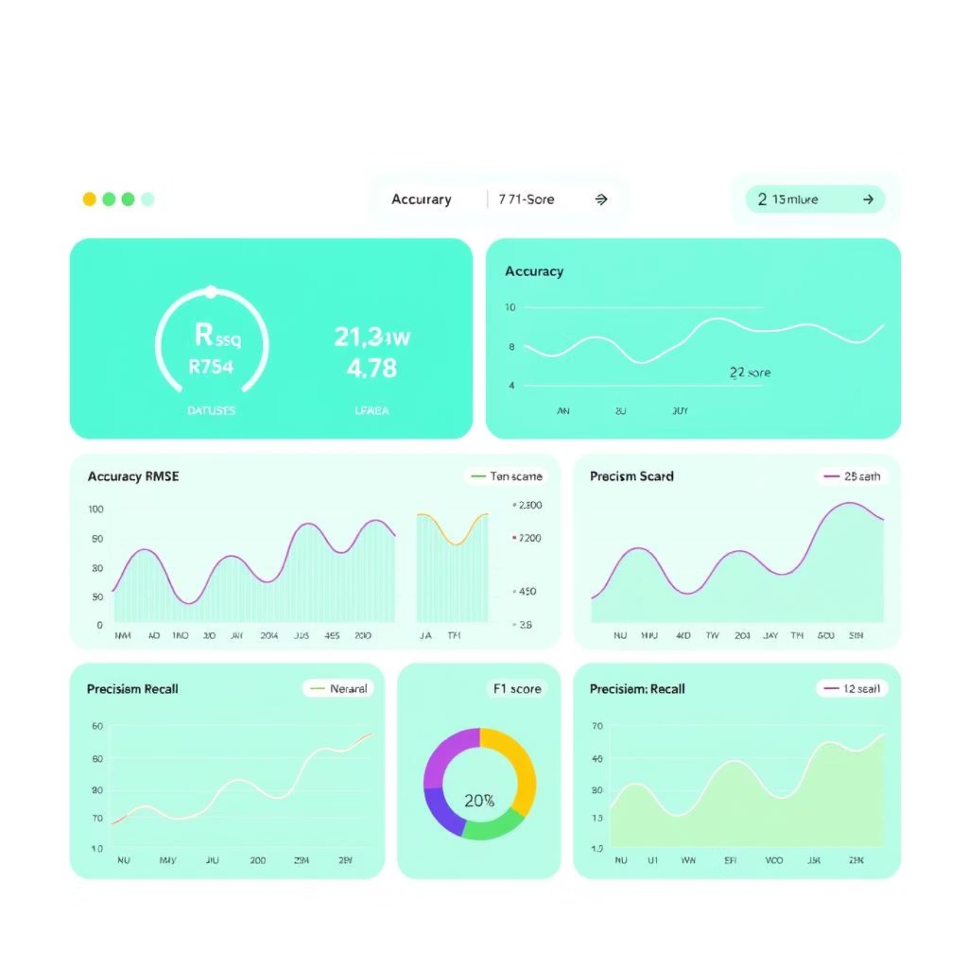
Model Evaluation: Unpacking Our Findings
Metrics Used:
R² (R-squared): Explained variance for regression models.
RMSE (Root Mean Squared Error): Quantified prediction accuracy for regression models.
Accuracy: Overall correctness for classification models.
Precision, Recall, F1-score: Detailed performance indicators for classification, balancing false positives and negatives.
Consistently, the Random Forest models (both Regressor and Classifier) demonstrated superior performance across all relevant metrics, showcasing their robustness and predictive power.

Slide 10
Key Insights: Top-Performing Models
Random Forest Regressor
Random Forest Classifier
Achieved the highest R² and lowest RMSE, indicating exceptional accuracy in predicting exact math scores. It effectively captured complex relationships within the data.
Demonstrated the highest accuracy and F1-score in classifying students into performance tiers (Low, Medium, High). Its robust generalization capabilities were confirmed through rigorous cross-validation, ensuring reliable real-world application.
Both models show strong generalization capabilities, crucial for real-world application and reliable predictions beyond the training data.

Slide 11

Conclusion: Empowering Educational Decisions
Predictive Power: Machine learning successfully provides a robust framework for predicting student academic performance, offering unprecedented foresight.
Early Intervention: The models enable early identification of at-risk students, allowing for timely and targeted interventions to support their success.
Data-Driven Strategy: These insights support educational stakeholders in making informed, data-driven decisions that can significantly enhance student outcomes and resource allocation.

Slide 12

Thank you.
Questions & Answers

